Slide 1
Introduction to Networks and Wireshark
Overview of Networking

Slide 2




What is a Network?
When you connect two or more computers or devices, you have “networked” them together
Networks can use wires and radio waves (wi-fi)
Usually, you want or need more than two devices talking to each other
Introduce more networking hardware to help
A router symbol shows both wired and wireless network

Slide 3
Speaking the Same Language
Information exchange must be done so that all parties can understand the information being shared
What happens if you show up to a class and your teacher is speaking Korean and you only know French? How well does that information exchange work?
There has to be an agreement on the language used for exchanging human information
Computers are the same – they need to agree on how to exchange information
These network protocols provide a common “language” for how to communicate

Slide 4
Network Protocols
Definition: A set of rules that governs the connection of computer systems to the internet (Oxford Dictionary)
Ever heard of TCP/IP?
TCP = Transmission Control Protocol
IP = Internet Protocol
The two protocols are used together to establish and maintain a network conversation
TCP focuses on establishing and maintaining a network connection
Connection-oriented, knows if a packet is missing
IP defines how computers send packets of data to each other

Slide 5
Network Protocols – Continued
In addition to TCP, there is UDP
UDP = User Datagram Protocol
Unlike TCP, UDP doesn't guarantee that the packets will get to the right destinations.
UDP uses IP (Internet Protocol) as well
UDP is connection-less
UDP is less reliable than TCP
Relies on devices in between the sending and receiving computers to correctly get the data where it's supposed to go

Slide 6

Network Traffic
“Straw” - Network
Packets on a network are pieces of a file that sent over the network and re-assembled on the receiving side.
Imagine the network is a straw and you want to push through a sandwich.
How do you do it? One small piece (packet) at a time.

Slide 7


Network Data Packets Concept Map
internet
Original Image
Image divided up into packet-sized data pieces
IP sends packet to network
Network
Packets get sent to destination
Individual Packet

Slide 8
IP Addresses
Source Address
How does a packet know where it came from and where it’s going to?
Just like a letter, is uses addresses.
Source Address - the IP address of where it’s coming from (like a return address)
Destination Address – the IP address of where it’s going to
Destination Address

Slide 9
IP Addresses
Source Address
10.0.0.15
How does a packet know where it came from and where it’s going to?
Just like a letter, is uses addresses.
Source Address - the IP address of where it’s coming from (like a return address)
Destination Address – the IP address of where it’s going to
Destination Address
93.184.216.34

Slide 10
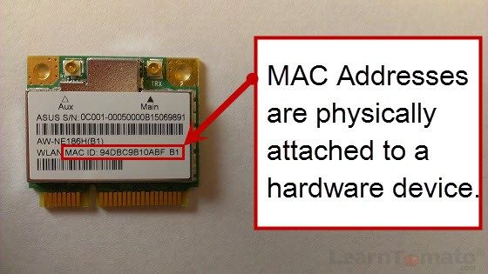
Other Identifiers – The MAC Address
Computers are assigned IP addresses through software (changeable)
The hardware has its own identifier, MAC address (non-changeable)
Assigned at manufacture time, the first three bytes map to manufacturer (OUI listing)
Can tell information about network hardware connected through the network traffic. The MAC address has (leaks) this information
MAC addresses can be spoofed (faked), but generally the way to identify a specific physical network device
Notes:
Image from https://learntomato.flashrouters.com/what-is-a-mac-address-how-to-find-my-mac-address/

Slide 11
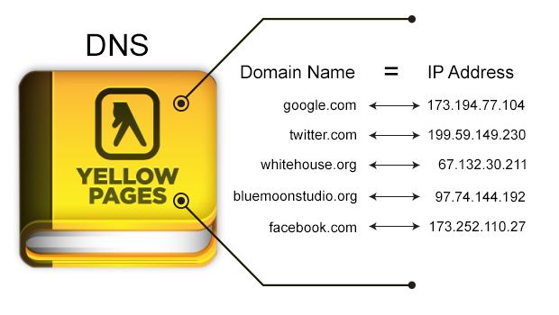
Not Lost in Translation
How do you get from “example.com” to the IP address 93.184.216.34?
Answer: the Domain Name System (DNS)!
DNS is like a phonebook for domain names mapped to IP addresses.
Notes:
Image from https://tibbbz.medium.com/pi-hole-dns-for-dummies-5763b65ee527

Slide 12
Ports
Port Number | Usage
23 | Telnet - Remote login service, unencrypted text messages
25 | Simple Mail Transfer Protocol (SMTP) E-mail Routing
53 | Domain Name System (DNS) service
80 | Hypertext Transfer Protocol (HTTP) used in World Wide Web
110 | Post Office Protocol (POP3) used by e-mail clients to retrieve e-mail from a server
123 | Network Time Protocol (NTP)
143 | Internet Message Access Protocol (IMAP) Management of Digital Mail
161 | Simple Network Management Protocol (SNMP)
194 | Internet Relay Chat (IRC)
443 | HTTP Secure (HTTPS) HTTP over TLS/SSL
Network ports indicate what type of service it is (email, file transfer, web).
Typical ports used when browsing the internet
Resolving a URL (www.example.com) to an IP address (198.41.0.4) uses the Domain Name System (DNS) on port 53
Unencrypted website traffic (HTTP) – Port 80
Encrypted website traffic (HTTPS) – Port 443
Notes:
Note about DNS. In the prior slide, the source and destination addresses are IP addresses.
Using TCP/IP, you can’t directly “go” to example.com. That first needs to use DNS to lookup the IP address, and then the request for the content at 198.41.0.4 is transmitted.

Slide 13

Do you think it’s possible to analyze data sent over the network?
Notes:
Yes! This is done for troubleshooting, performance measurements, and for security monitoring.

Slide 14
Wireshark
Wireshark is a powerful analysis software that allows you to not only capture network and device packets, but to analyze them too (i.e., a packet analyzer).
Remember - A packet is a fragment of data that is sent over a network from one machine to another. This data usually includes a source port, source IP address, destination port, destination IP, and other data that we will see in this lab.
Wireshark allows a user to analyze the traffic traveling in and out of the machine, which can serve many uses.
© 2020 Virginia Cyber Range. Created by Thomas Weeks. (CC BY-NC-SA 4.0)

Slide 15

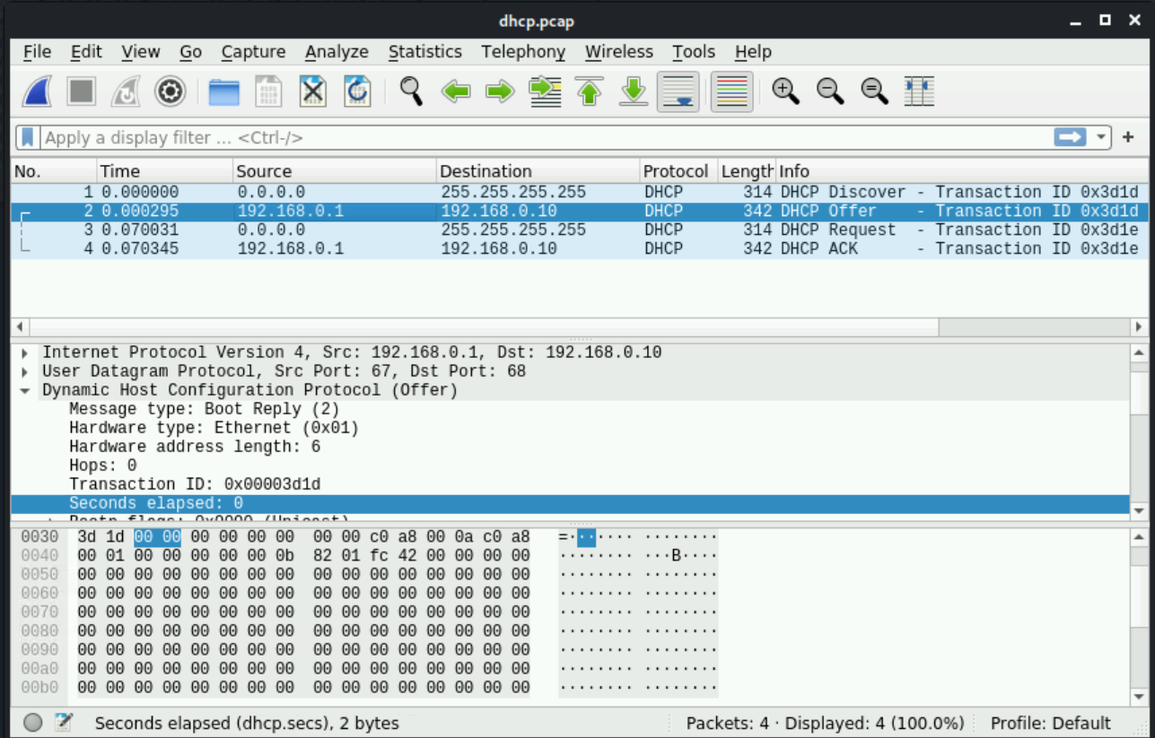
Wireshark
© 2020 Virginia Cyber Range. Created by Thomas Weeks. (CC BY-NC-SA 4.0)

Slide 16

Attack of the Sharks
≠

Slide 17
Why Use Wireshark?
Troubleshoot network connections.
Filter data between two hosts to see a single network “conversation.”
Comparing all “conversations” to discover bad actors or “bandwidth hogs.”
Filter captured data to analyze specific protocols and ports being used.
Analyze specific statistics about the traffic coming in and out of the system.
Adapted from © 2020 Virginia Cyber Range. Created by Thomas Weeks. (CC BY-NC-SA 4.0)

Slide 18
Wireshark Lab
Wireshark allows you to view pieces of data (called packets) in real-time as they go in and out of a system and can be saved as packet capture or pcap files.
In this lab, you will be analyzing packet capture files (network forensics).
The objectives at the end of the lab is understand:
Wireshark overview
Analyzing DNS Packets
Name-to-IP address resolution
Wireless access points and identifiers

Slide 19

Debrief

